Slide 1
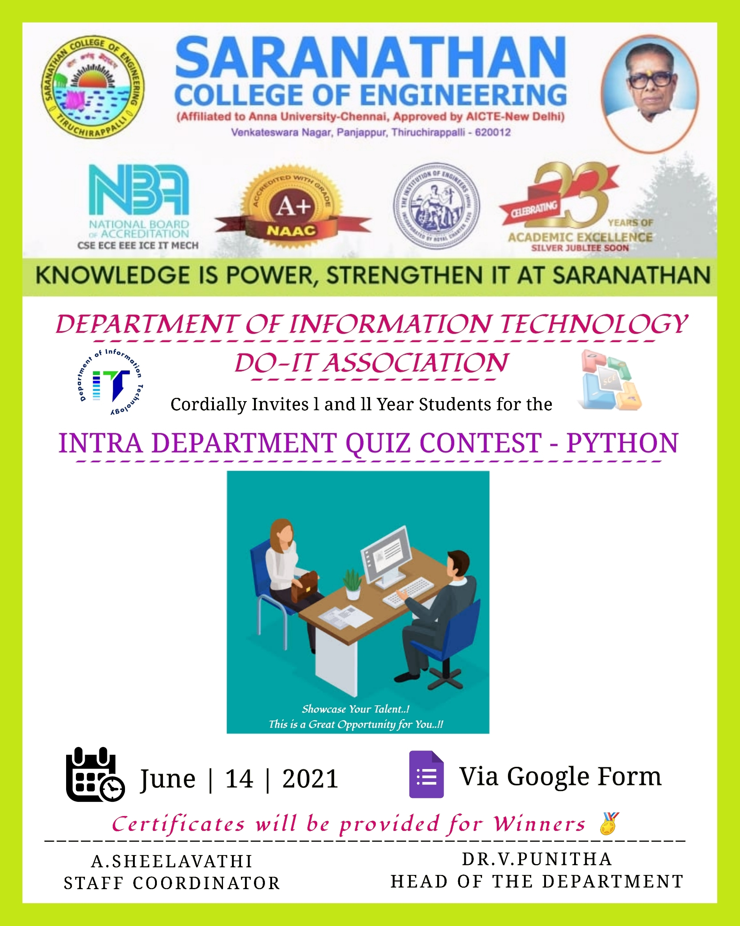
I N F O B O T WEB BASED CHATBOT
DEPARTMENT OF INFORMATION TECHNOLOGY
NAME OF THE GUIDE:
Ms.J.SANGEETHAPRIYA.,M.TECH.
Assistant Professor,
Information Technology.
PRESENTED BY :
A.S. ABISHEK - 813819205004
S.R. HARSHAVARTHAN - 813819205020
A.RATNAKUMAR - 813819205051
SEENI ARIVAZHAKAN - 813819205053
,

Slide 2
OUTLINE
ABSTRACT
OBJECTIVE
LITERATURE SURVEY
ARCHITECTURE
MODULES
SCREENSHOTS
CONCLUSION
REFERENCES

Slide 3
ABSTRACT
A web based chatbot is designed to interact with users via text or voice on a website.The purpose of web based chatbot is to provide a immediate assistance to users by answering frequently asked questions,providing information,and facilitating transactions.
Nowadays, a lot of corporate websites have started adopting chatbots as support, whether it be for finance or as a means of virtual contact.
RNN based Deep Learning and PyTorch Model are the algorithms used.

Slide 4
OBJECTIVE
An FAQ Chatbot is an easy way to help visitors, customers, or even staff get rapid access to information. Based on the format of question and answers, the chatbot will use (Machine learning)ML to identify the most appropriate answer to whatever the user types in.
Using machine learning algorithms to increase the dataset of questions and answers and ensure that the mapping of questions and answers remain maintained every time there is an increase in the dataset.

Slide 5
LITERATURE SURVEY
S.No | Year | Author | Title | Merits | Demerits
1 | APR 2020 | Giancarlo Sperli | A Deep Learning based Chatbot for Cultural Heritage | In this paper the proposed Chatbot is based on deep learning techniques for supporting user’s cultural heritage path. Moreover, the proposed Chatbot is able to respond in both Italian and English languages. | Future works will be devoted to extend the evaluation using a larger number of users and improving the Deep Learning approach using an online learning strategy.
2 | JUN 2021 | Achmad Ramaditiya,Suci Rahmatia,Aris Munawar,Octarina Nur Samijayani | Implementation Chatbot Whatsapp using Python Programming for Broadcast and Reply Message Automatically | This Chatbot program is designed to be able to read messages that are not sensitive, so that if have a similar message, the message will still be read and entered into the Chatbot system. This insensitive sentence can we design according to the requests and needs in the Chatbot program. | This research can still be developed by adding a random message feature. So, the server doesn't need to save the contact number first to spread the messages. This research can also use a system that can read all messages and send them back directly without having to enter the contact's name.

Slide 6
S.No | Year | Author | Title | Merits | Demerits
3 | DEC 2022 | Sanjay Chakraborty, Hrithik Paul, Sayani Ghatak, Saroj Kumar Pandey, Ankit Kumar, Kamred Udham Singh, Mohd Asif Shah | An AI-Based Medical Chatbot Model for Infectious Disease Prediction | This bot offers medical-related information like doctor’s contact details, address of nearby hospitals, contact details for getting an oxygen cylinder, about the disease its symptoms, its prevalence, diagnosis, and its treatment procedures. | This medical chatbot has wide future opportunities. People in remote areas can also receive benefits from this. Here we use ‘TensorFlow’, which helps to build the NLP for chatbots and utilizes deep neural network architecture.
4 | APR 2021 | Manik Rakhra, Gurram Gopinadh, Narasimha Sai Addepalli, Gurasis Singh, Shaik Aliraja, Vennapusa Siva Ganeshwar Reddy, Muthumula Navaneeswar Reddy | E-Commerce Assistance with a Smart Chatbot using Artificial Intelligence | This paper is intended to introduce a chatbot based on the Ecommerce engine which seeks to improve the user's engagement with E-Commerce engine. Chatbot stores a variety of answers, but can also consider intricate user feedback and hence includes appropriate answers and product recommendations. | Grammar-based data parsing is needed for efficient Chatbot applications in order for the user to comprehend the intended sentence by defining phrases that are suited to the complexities of the grammar used

Slide 7
S.No | Year | Author | Title | Merits | Demerits
5 | DEC 2020 | Mohammad Monirujjaman Khan | Development of An e-commerce Sales Chatbot | The system has a visual platform to train the NLU Engine. It is a single page application which serves all the frontend login and the views as a single file whenever user browses the site, it reduces server side call, improves performance and provides a smooth experience. Users can handle intents, texts, entities and entity synonyms easily using the platform | Artificial Neural Network can be used to improve the accuracy of the NLU Engine. Also, a semi supervised learning system can be implemented in order to increase the dataset. The platform can be made available to word press based system because 60% ecommerce websites are powered by woo commerce which is a word press plugin

Slide 8
ARCHITECTURE DESIGN
Chatbot platform
Resides on the system
Natural
language
question
Language
parsing
User
Bot Engine
Knowledge
base
Natural
language
answer

Slide 9
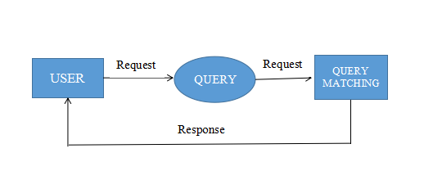
MODULES AND IT’S DESCRIPTION
User: The user enters their query in the chatbot and the chatbot produces the response based on the trained datasets.

Slide 10
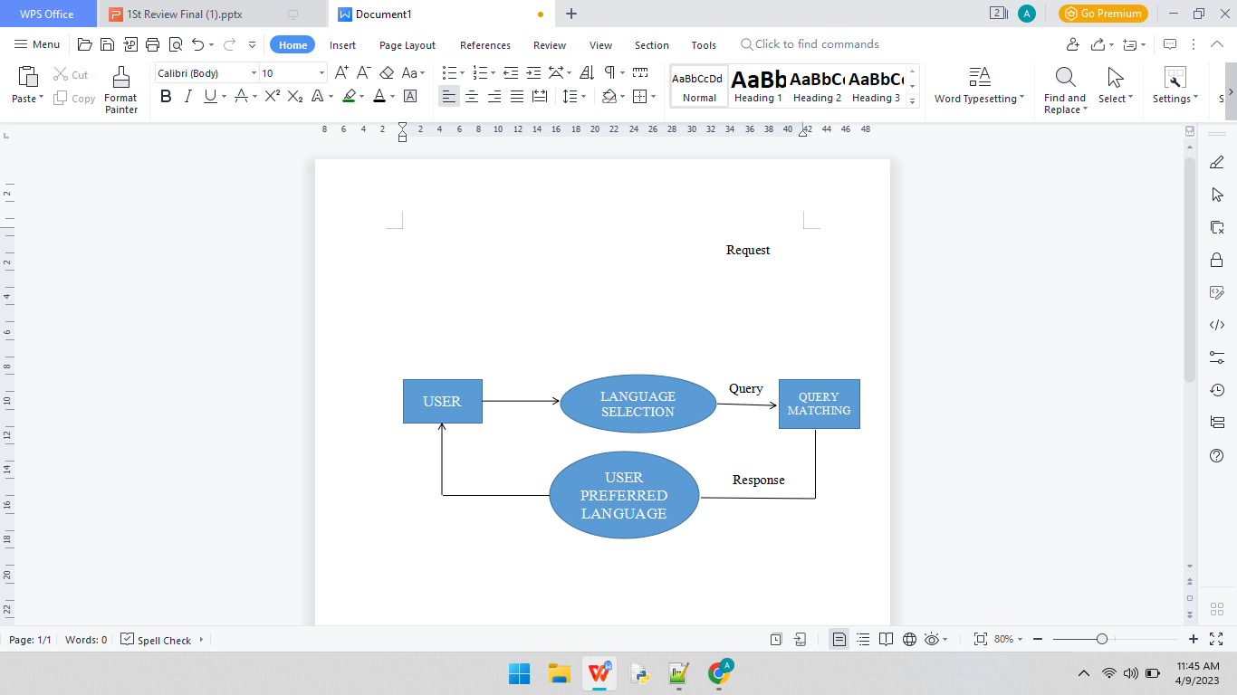
MODULES AND IT’S DESCRIPTION
Multi-Language: The user can select the language as per their preference and the enters their query.The chatbot produces the response based on the user preferred language.

Slide 11
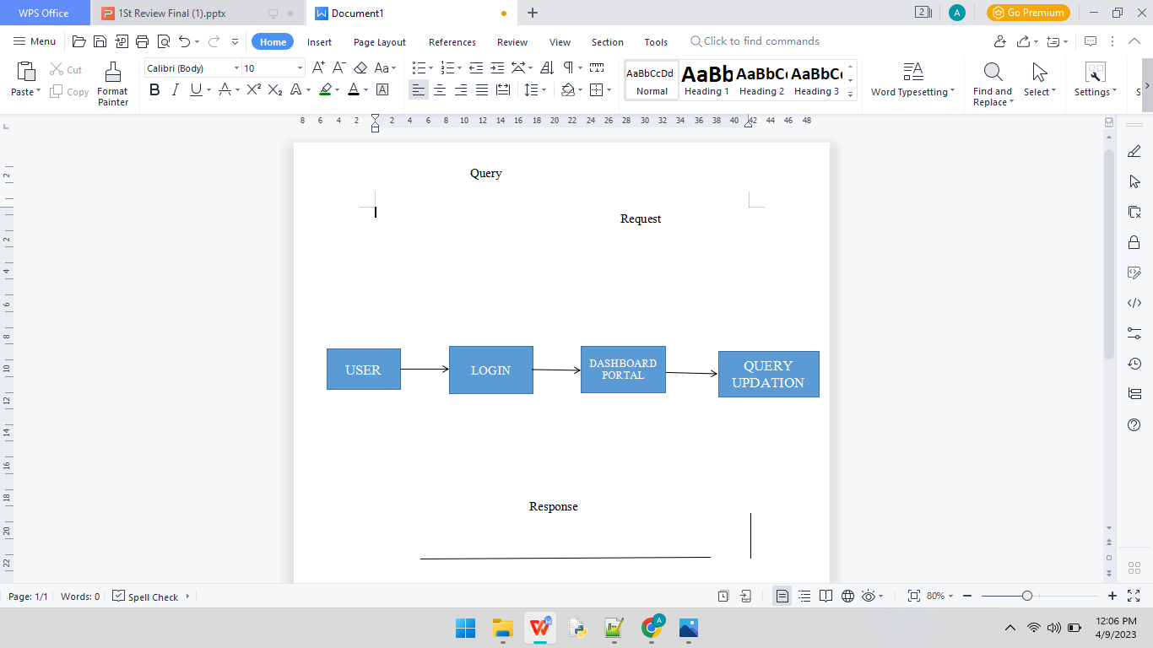
MODULES AND IT’S DESCRIPTION
Admin: The admin enters the login credentials and can modify the datasets.

Slide 12
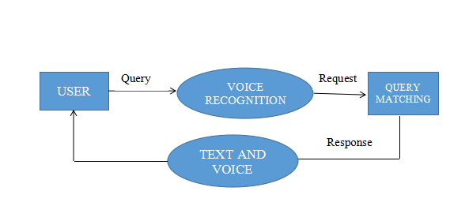
MODULES AND IT’S DESCRIPTION
Speech Recognition: The user can give the query as speech and the chatbot produces the response as both in speech and also as text.

Slide 13
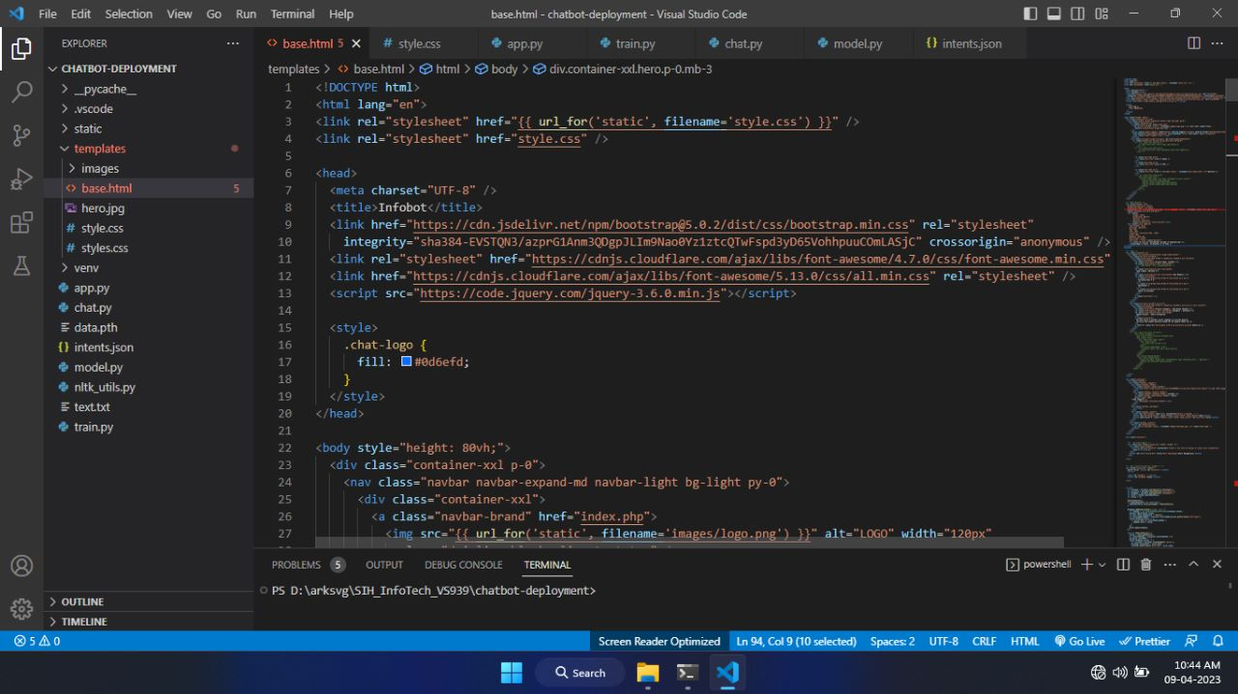
IMPLEMENTATION
Code:

Slide 14
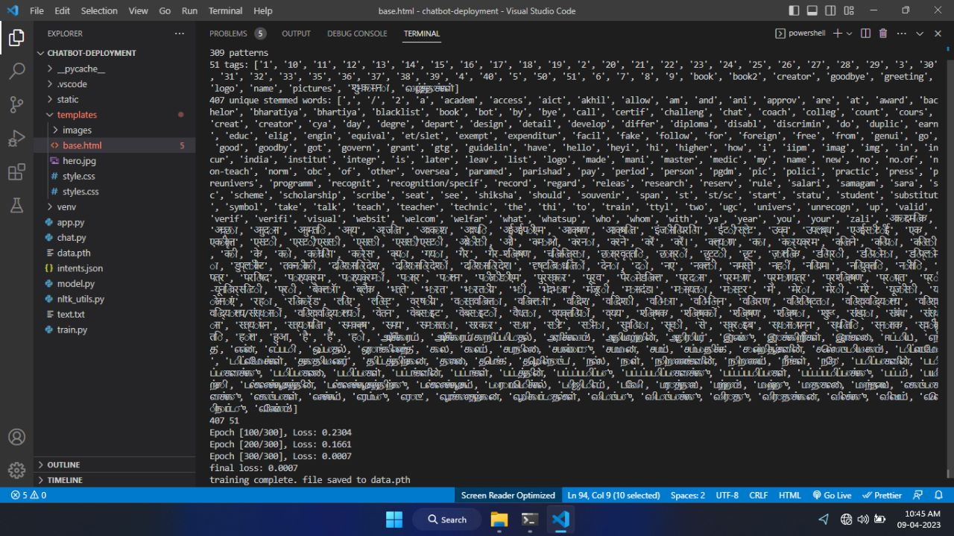
Data Training:

Slide 15
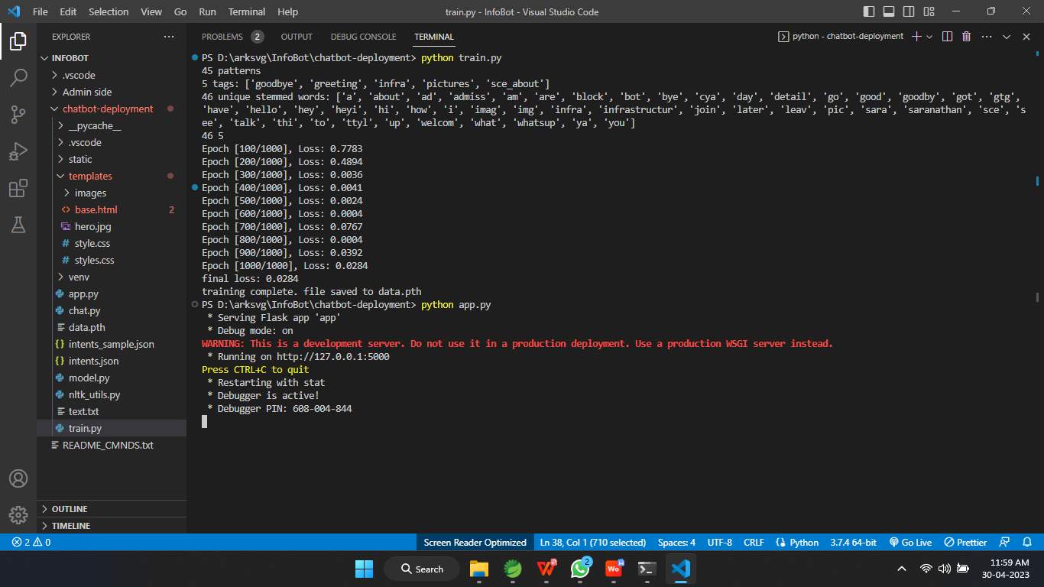
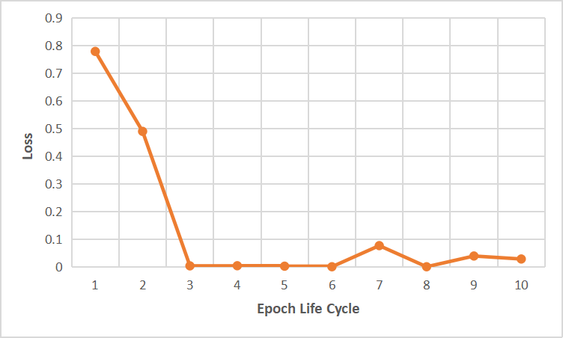
Number of Epochs Trained
Loss Accuracy

Slide 16
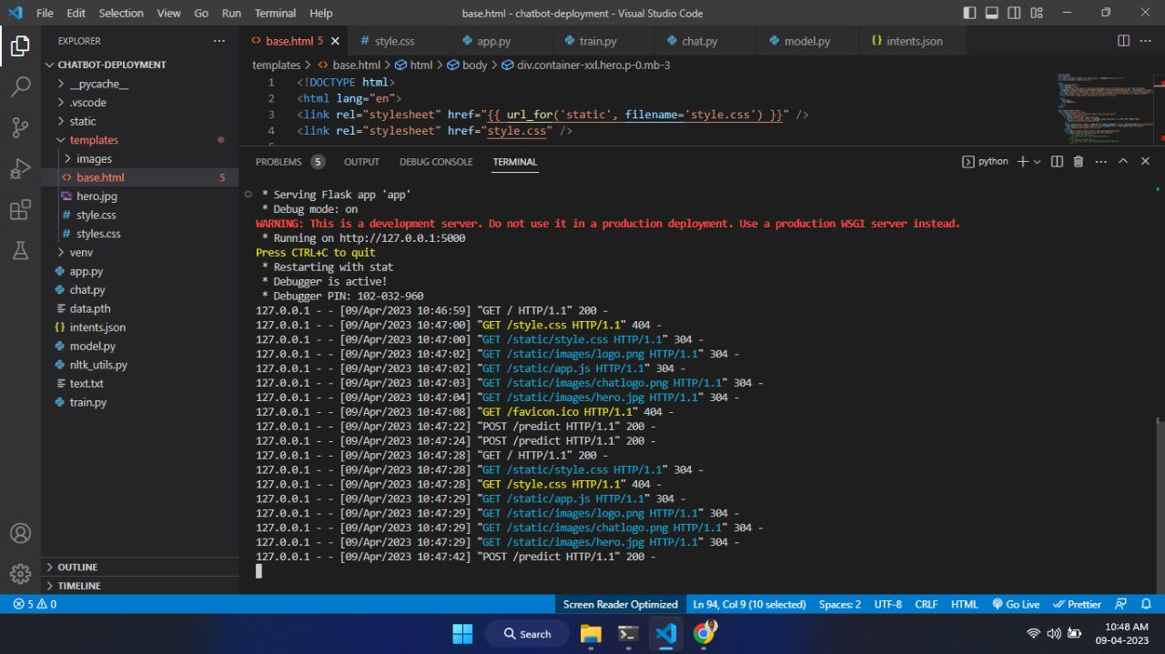
Server Deployment:

Slide 17
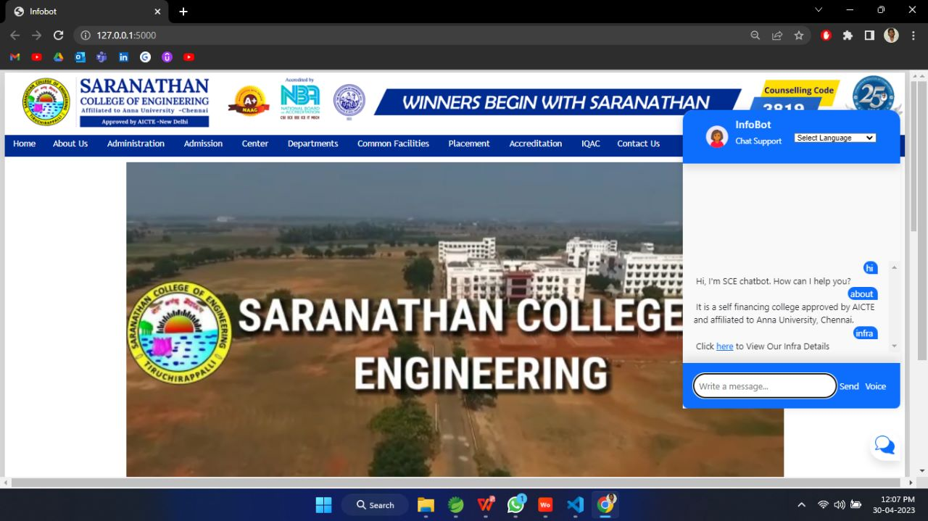
OUTPUT
User Interaction

Slide 18
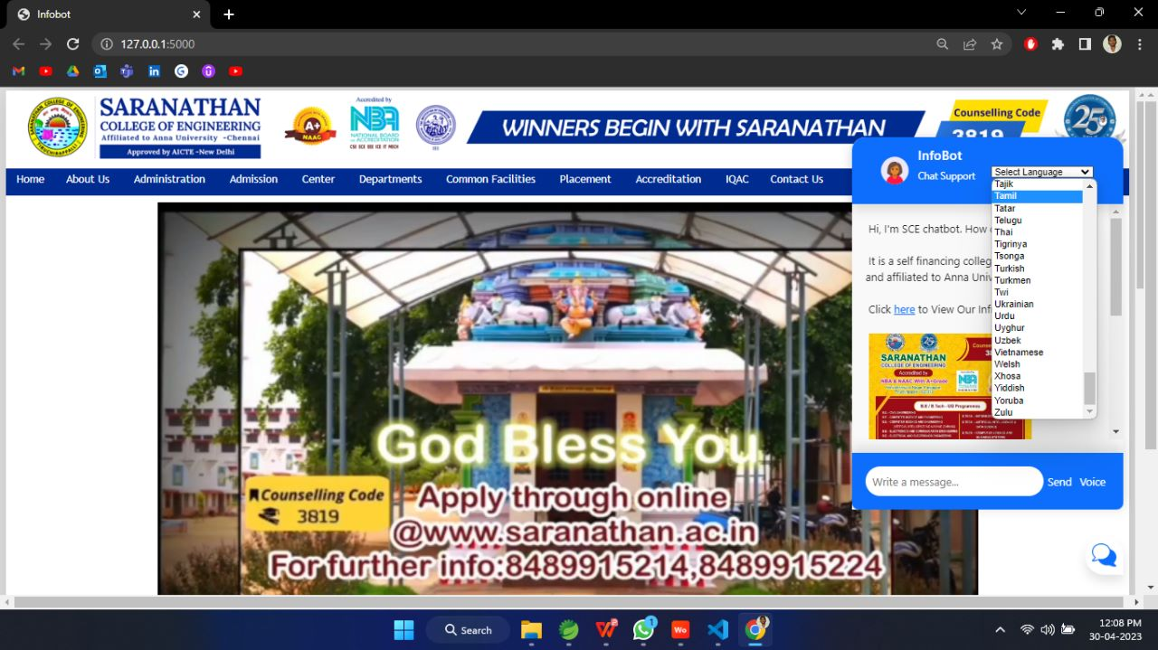
Multi-Language

Slide 19
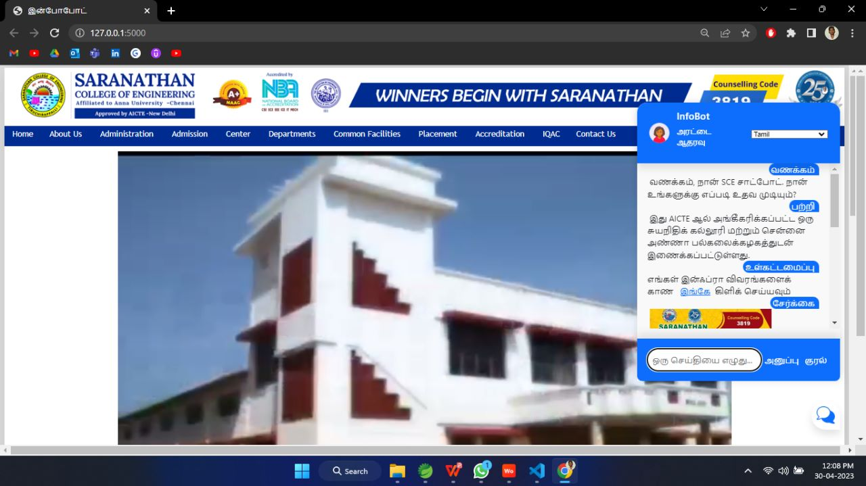
Content Translation
Multi-Language

Slide 20
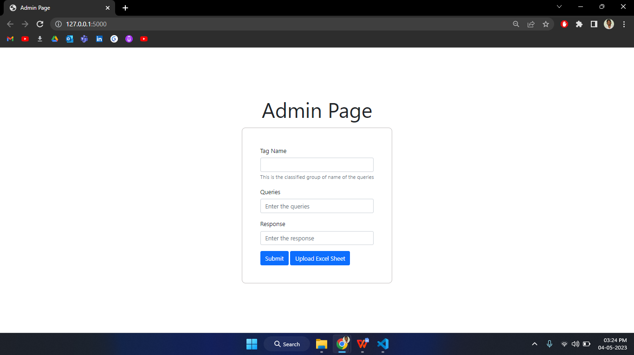
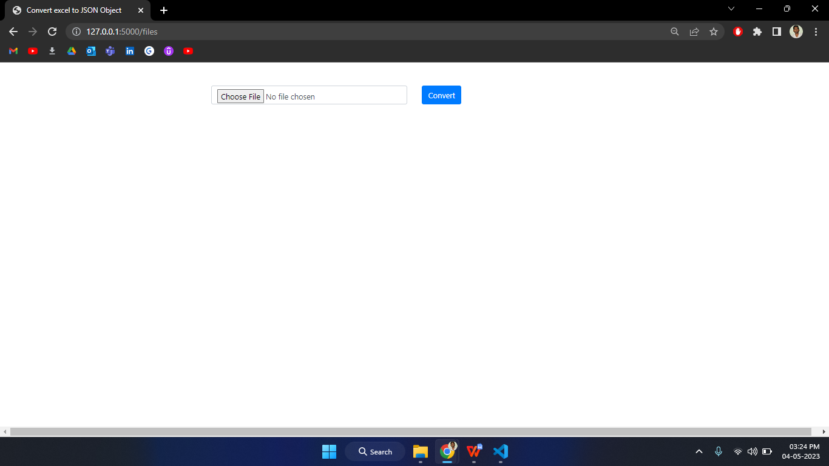
Admin Module

Slide 21
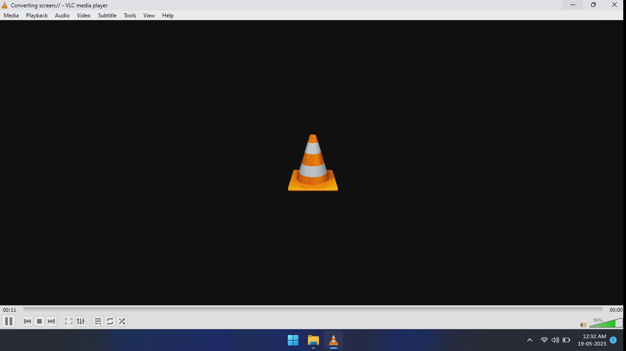
CHATBOT WORKING VIDEO

Slide 22
CONCLUSION AND FUTURE WORK
This Web Chatbot is user friendly in nature.The chatbot will be available 24x7. So the user can use the chatbot at any time. When the user asking the questions the chatbot fetches the answer and provides in the web page. Now the user will get a response and Easy navigation too. The response time of our chatbot to the user queries is 0.2 milli seconds. And the loss time for our chatbot to the user queries is 0.03 milli seconds.
While we saw how chatbots evolved and performed as of now, the future of chatbots is even more exciting. The enhancement that makes the chatbot even more unique as well as well performing are,Integrating the chatbot with other services like a CRM system, customer support ticketing system, or social media channels can improve the user experience by streamlining workflows and providing more personalized responses.

Slide 23
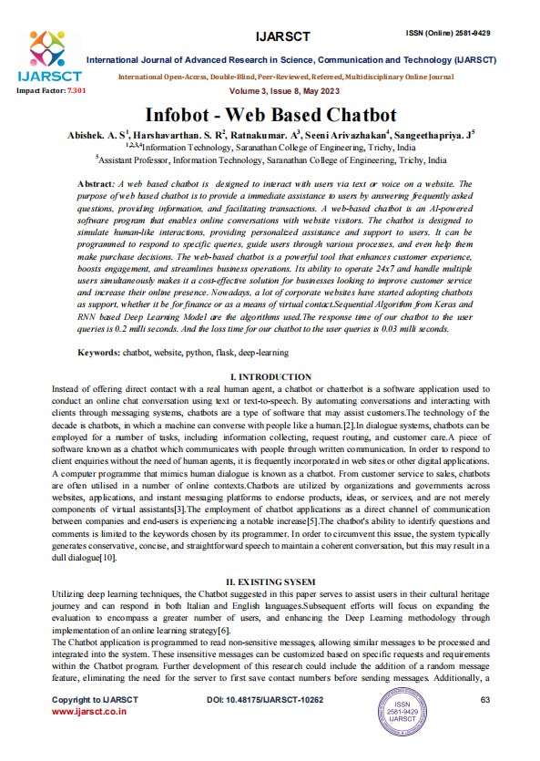
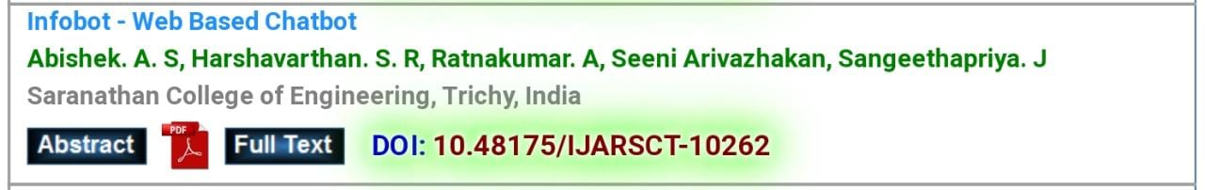
JOURNAL PUBLICATION
ISSN No : 2581-9429
DOI : 10.48175/IJARSCT-10262
Link : https://ijarsct.co.in/May3i8.html

Slide 24
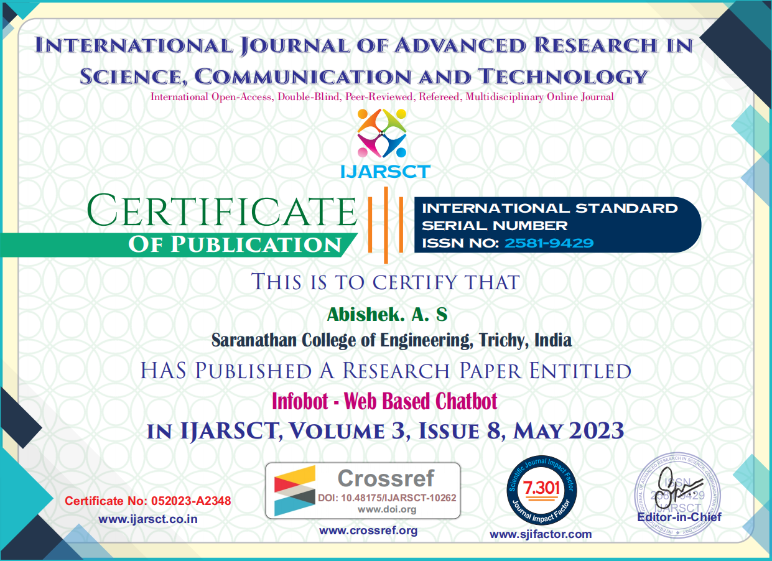

JOURNAL PUBLICATION CERTIFICATIONS

Slide 25




Slide 26
REFERENCES
[1] Achmad Ramaditiya,Aris Munawar,Octarina Nur Samijayani,Suci Rahmatia.Date of Conference: 29-30 June 2021.Implementation Chatbot Whatsapp using Python Programming for Broadcast and Reply Message Automatically.DOI: 10.1109/ISESD53023.2021.9501523.
[2] Adamopoulou and L. Moussiades, "An overview of chatbot technology", IFIP International Conference on Artificial Intelligence Applications and Innovations,
pp. 373-383, 2020.
[3] Adamopoulou and L. Moussiades, "Chatbots: History technology and applications", Machine Learning with Applications, vol. 2, pp. 100006, 2020.
[4] Ankit Kumar,Hrithik Paul,Kamred Udham Singh,Mohd Asif Shah,Sanjay Chakraborty,Saroj Kumar Pandey,Sayani Ghatak.Date of Publication: 06 December 2022.An AI-Based Medical Chatbot Model for Infectious Disease Prediction.DOI: 10.1109/ACCESS.2022.3227208

Slide 27
REFERENCES
[5] Ed-Douibi, J. L. C. Izquierdo, G. Daniel and J. Cabot, "A Model-based Chatbot Generation Approach to Converse with Open Data Sources", arXiv preprint arXiv:2007, vol. 10503, 2020.
[6] Giancarlo Sperli.SAC '20: Proceedings of the 35th Annual ACM Symposium on Applied ComputingMarch 2020.https://doi.org/10.1145/3341105.3374129.
[7] Gurasis Singh,Gurram Gopinadh,Manik Rakhra,Muthumula Navaneeswar Reddy,Narasimha Sai Addepalli,Shaik Aliraja, Vennapusa Siva Ganeshwar Reddy.Date of Conference: 28-30 April 2021.E-Commerce Assistance with a Smart Chatbot using Artificial Intelligence.DOI: 10.1109/ICIEM51511.2021.9445316.

Slide 28
REFERENCES
[8] Khan and M. R. Rabbani, "Chatbot as islamic finance expert (caife) when finance meets artificial intelligence", Proceedings of the 2020 4th International Symposium on Computer Science and Intelligent Control, pp. 1-5, 2020.
[9] Mohammad Monirujjaman Khan.Date of Conference: 14-16 December 2020.Development of An e-commerce Sales Chatbot.DOI: 10.1109/HONET50430.2020.9322667.
[10] Norihide Kitaoka,Takahiro Kinouchi,"A response generation method of chat-bot system using input formatting and reference resolution",Date of Conference: 28-29 September 2022,Date Added to IEEE Xplore: 02 November 2022,INSPEC Accession Number: 22212574,DOI: 10.1109/ICAICTA56449.2022.9932928
[11] https://stackoverflow.com/
[12] https://www.codegrepper.com/
[13] https://developer.mozillz.org/en-US/docs/

